Slide 1
The Joys of Javascript
Day 7
May 2, 2016

Slide 2
Admin Items

Slide 3
Homework #2 – Questions?
Two parts to the assignment
Take existing Portfolio and apply Media Queries and Viewport to make mobile responsive.
Find a Bootstrap theme you like and apply the Bootstrap theme to your website.

Slide 4
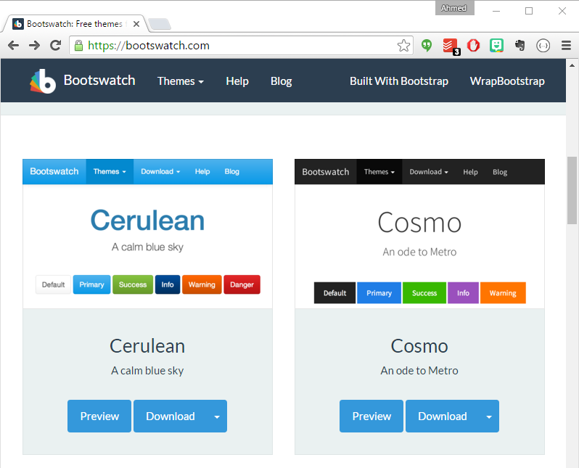
Bootswatch Styling
https://bootswatch.com/

Slide 5
Demo Time
Instructor: Demo
(layout.html | 0-Bootswatch)
Notes:
At the end of the demo explain the painfully short front-end portion and its purpose as the first thing you learn – with the longest time in class to draw from our expertise. Its actually tricker than the backend.

Slide 6
Today’s Class!

Slide 7
Objectives
In today’s class we’ll be introducing:
Javascript Definitions
Javascript Basics:
Variables
Logging, Alerting, Prompting
Arrays
If-Then Statements
Notes:
You will be introduced to all this… yep. This is like two weeks of class at GA condensed into one class

Slide 8
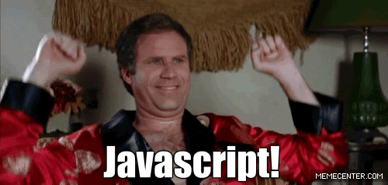
OMG Javascript!
Prepare to become true coders.

Slide 9
How to Learn Javascript

Slide 10
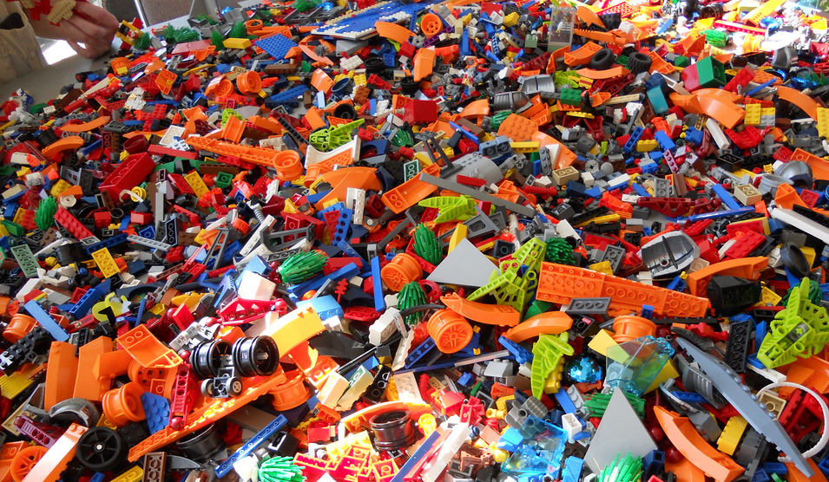
Your Brain on Javascript…
Notes:
Looks like the floor in my sons room. My feet are crying just thinking about it. There are going to be tons of little pieces of js floating around in your brain, it is knowing how to piece all these little code blocks together that will be key

Slide 11
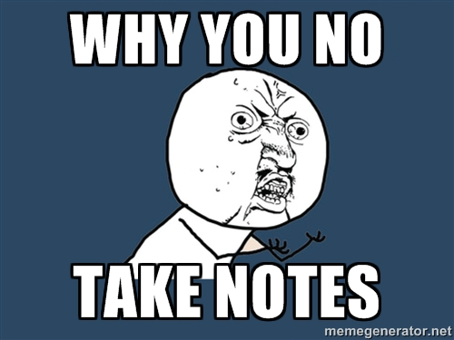
Time to Take Notes…
Notes:
Focus on taking notes primarly on why something is important and how you use it.

Slide 12
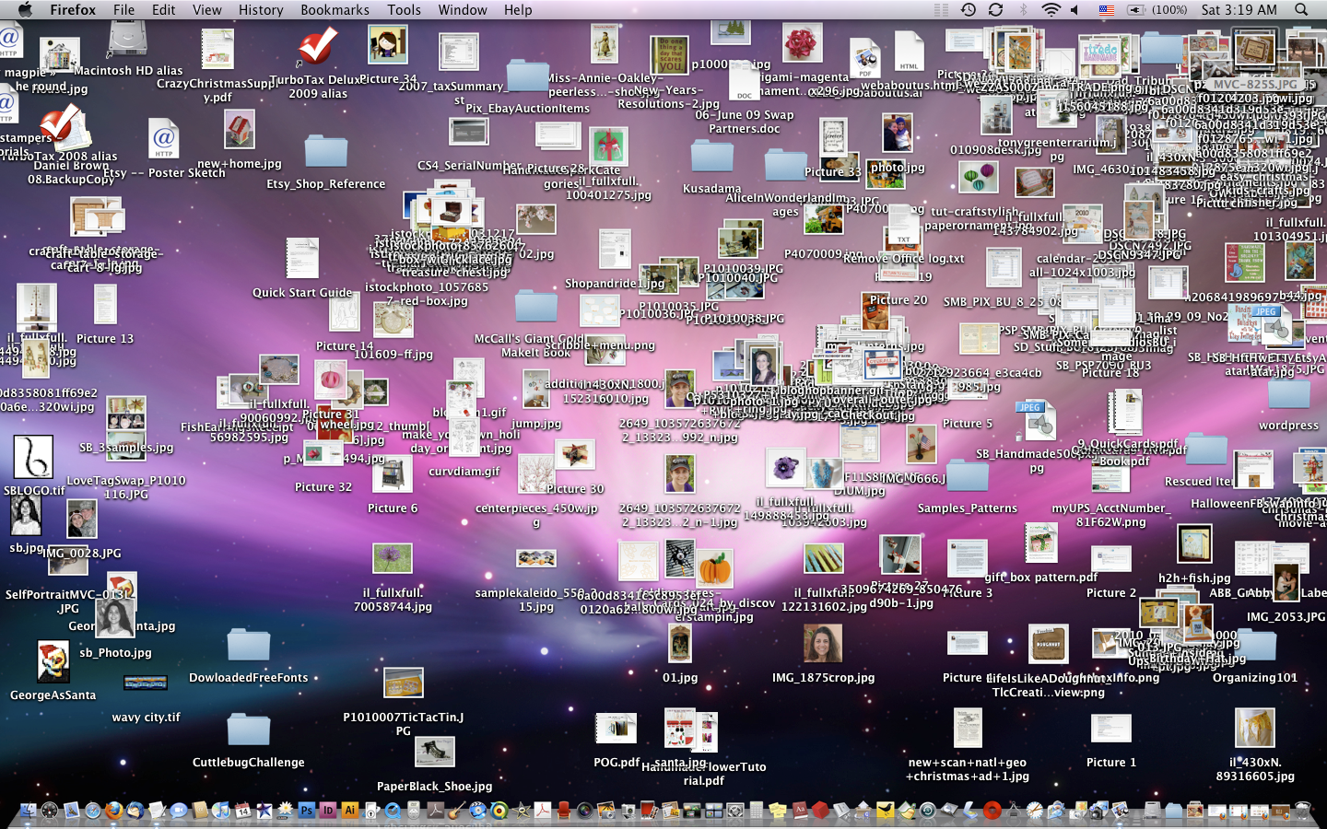
And Keep Organized!!!
Notes:
Folder organization – one file is open but you think you are working on another, they are going to have similar names, index.html, style.css index.js

Slide 13
Overall Tips
Review Immediately: We’ll be building upon these concepts quickly. The firmer your grasp now, the better off you’ll be.
Re-do the exercises in class: Don’t just re-read! Actually spend the time to re-do them from scratch on your own.
Get Help: Come to office hours. Ask conceptual questions. Ask specific questions. Just keep asking questions!
Don’t be Afraid: You will get this. It will take time, but you will get this. Just keep at it. Patience will pay off.
Notes:
JS is introduced quickly so we have lots of time to get our hands dirty, get in there and f some stuff up… with js

Slide 14
Warmup Activity

Slide 15
> YOUR TURN!!
Code Dissection:
Download the code sent to you via slack.
Open it in Chrome and watch what happens.
Then open the file in Sublime and try to explain to someone around you how the code connects to the events seen on the page.
p.s. I know we haven’t covered Javascript before…
MAJOR p.s. When downloading any code going forward, be sure to hit “Download”. If you copy and paste directly from Slack, your code will not work.
Notes:
No review, mention we will come back to it later.

Slide 16
What is Javascript?

Slide 17

Javascript Definitions
Javascript is the third of the three fundamental programming languages of the modern web (along with HTML, CSS)
Javascript allows developers to create dynamic web applications capable of taking in user inputs, changing what’s displayed to users, animating elements, and much more.
Notes:
Introduce the model HTML, view CSS and controller JS idea,

Slide 18
Variables

Slide 19
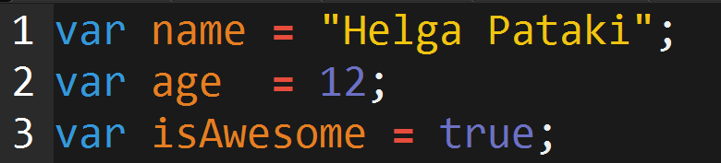
Basic Variables
Variables are the nouns of programming.
They are “things” (Numbers, Strings, Booleans, etc.)
They are composed of variable names and values
Notes:
So js vars can hold these pieces of primitive data, strings, numbers , Booleans, etc

Slide 20
INSTRUCTOR DEMO!
Variable Assignment
Notes:
Not an assignment for you to do, although that is coming, variable assignment means giving a variable a value, like dropping something into a slot or parking a car in a parking space parkingSpace=“Green Volvo”;

Slide 21
Demo Time
Instructor: Demo
(BasicVariablesDemo | 02-BasicVariablesDemo)

Slide 22
Basic Variables (Syntax)
Var Keyword
Variable name
Assignment
Value
Termination
var
name
=
“Helga”
;

Slide 23
Basic Variables (Syntax)
Var Keyword
Variable name
Assignment
Value
Termination
var
name
=
“Helga”
;
Be sure to notice the quotes (“”),
which convey that Helga is a string

Slide 24
> YOUR TURN!!
Code Creation:
Using the instructions in the file sent to you, fill in the missing Javascript code to create variables.
When done, open the file in Chrome and check the output.
If you completed the activity correctly, you should see a series of pop-up windows with text inside.
Then look at the rest of the code to understand why the text displayed the way it did.

Slide 25
Logs, Prints, Alerts

Slide 26
Demo Time
Instructor: Demo
(ConsoleDemoInstructor.html | 04-ConsoleLogDemo)

Slide 27
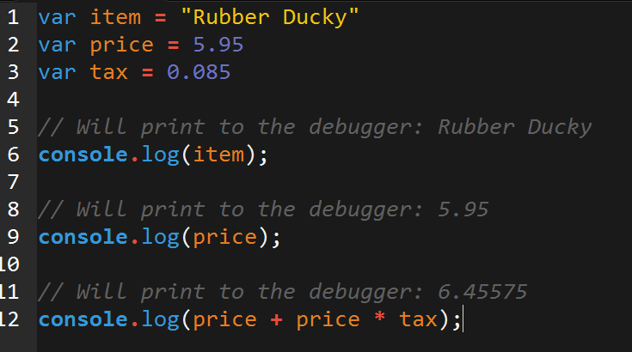
Console.log
console.log is a quick expression used to print content to the debugger.
It is a very useful tool to use during development and debugging.

Slide 28
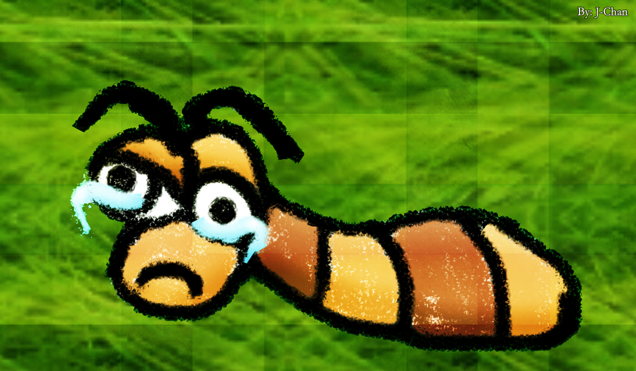
Sad Little Bug…
Hey Class!
How do you comfort a Javascript bug?

Slide 29

Sad Little Bug…
Hey Class!
How do you comfort a Javascript bug?
You “console” it.

Slide 30
Sad Little Bug…
Don’t worry!
It was a hilarious joke… that will make sense in a few weeks.

Slide 31
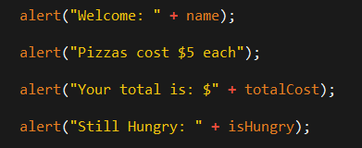
> YOUR TURN!!
Code Creation:
Take your previous code from the pizza example, then replace all of the alert messages with console.log.
Then open the file in the browser and open up chrome Developer tools -> Console to confirm the changes worked.
Talk to those closest to you about the difference between alert and console.log

Slide 32
INSTRUCTOR DEMO!
Alerts, Prompts, Confirms

Slide 33
Demo Time
Instructor: Demo
(PromptDemo.html | 06-PromptDemo)

Slide 34
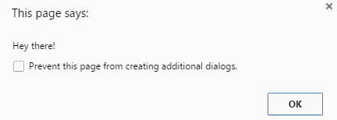
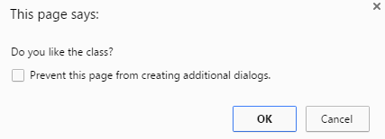
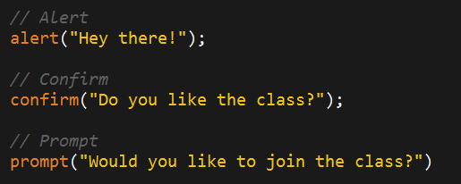
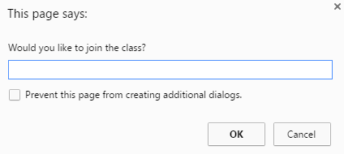
Alerts, Prompts, Confirms
Alerts, Confirms, and Prompts will create a popup box in the browser when run.
These are also useful for development and debugging.

Slide 35
> YOUR TURN!!
Code Creation:
Create code using Javascript that does all of the following:
Asks the user with a confirm: “Do you like _____” and store it into a variable.
Ask the user “What kind of ________” do you like with a prompt and store that into a variable.
Alert both variables to the screen.

Slide 36
Document Write

Slide 37
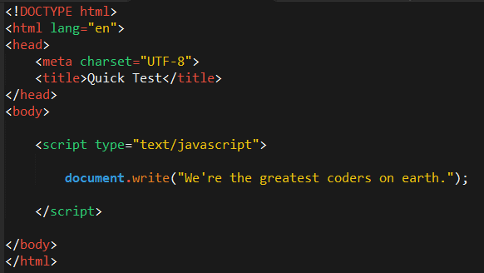
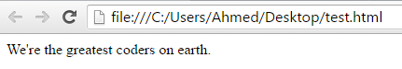
Writing to HTML
We can also use Javascript to directly write to the HTML page itself using document.write( ).
Later we will go over much more advanced approaches for writing HTML using Javascript and jQuery.
Test.html (chrome)
Test.html (sublime)
Notes:
Write strings to the document, html tag, the values of variable, outcome of calculations

Slide 38
If-Then Statements

Slide 39
Demo Time
Instructor: Demo
(conditionaldemo.html | 08-ConditionalDemo)

Slide 40
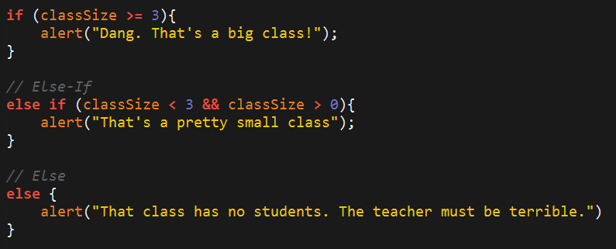
If-Then Statements
If-Then statements are critical.
Each statement is composed of an if, else-if, or else (keyword), a condition, and the resulting code in { } curly brackets.
Notes:
Our applications must be able to make decisions based on conditions, these are conditionals

Slide 41
> YOUR TURN!!
Code Creation:
Create a website that asks users if they eat steak.
If they do then write the following to the screen: “Here’s a Steak Sandwich”
If they don’t then write the following to the screen: “Here’s a tofu stir fry”
Bonus: Ask what the user’s birth year is. If they are under 21, post: “No Sake for you!”
Hint: You will need to use document.write( ) from the last activity

Slide 42
> YOUR TURN!!
Code Dissection:
Open the file sent to you in Sublime.
Then with a partner, go through and predict what the result of each “conditional” statement will be (i.e. will the “if” or the “else” be triggered).
Then run the program to check if you are right. Note any that you got wrong and ask about it in class.

Slide 43
Arrays

Slide 44
The Zoo Pen
Array Name: zooAnimals
Zebra
Rhino
Giraffe
Owl
Index 0
Index 1
Index 2
Index 3

Slide 45
The Zoo Pen… Coded
Array Name: zooAnimals
Zebra
Rhino
Giraffe
Owl
Index 0
Index 1
Index 2
Index 3
Coded in Javascript using an Array

Slide 46
INSTRUCTOR DEMO!
Arrays

Slide 47
Demo Time
Instructor: Demo
(ArraysDemo.html | 11-ArraysDemo)

Slide 48
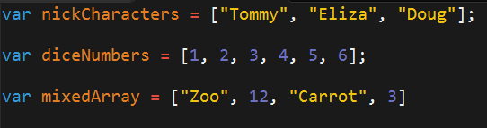
Basic Arrays
Arrays a type of variable that are collections.
These collections can be made up of strings, numbers, Booleans, other arrays, objects, anything.
Each element of the array is marked by an index. Indexes always start with 0.

Slide 49
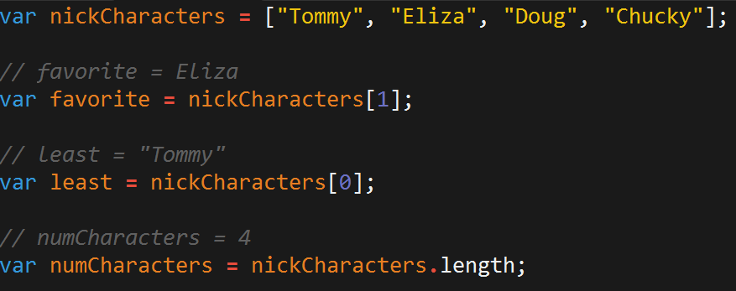
Basic Arrays Indices
To recover the value at any specific index you include the name of the array with a square bracket [ ] and inside the bracket is the element’s index.
You can easily grab the number of elements in the array using the method array.length.

Slide 50
> YOUR TURN!!
Class Code Dissection:
Take a few moments to look over the following file with a partner.
Then create a comment line above each console.log() line to “predict” what the output will be.

Slide 51
Homework #3

Slide 52
Questions?

Slide 53
Challenge Activity?

Slide 54
> YOUR TURN!!
Code Creation (Challenge):
Create a website that checks if users favorite band is one of your favorite bands.
If it is one of your favorite bands, then create an alert saying: “YEAH I LOVE THEM”.
If it’s not create an alert saying: “Nah. They’re pretty lame”
Hint: You will need to research how to use .indexOf()
Hint: You will need to research how to use .toLowerCase()

Slide 55
> YOUR TURN!!
Code Dissection (Re-examined, Time-permitting):
Re-examine the file sent to you at the start of class.
See if you can better understand how it works – after having gone through today’s class.

